Slide 1
Splunk Reports and Alerts
SIEM Day 3
‹#›

Slide 2

Class Objectives
By the end of class, you will be able to:
Use the SPL commands stats and eval to create new fields in Splunk.
Schedule statistical reports in Splunk.
Determine baselines of normal activity to trigger alerts.
Design and schedule alerts to notify if an attack occurs.
‹#›

Slide 3
Activity: Splunk Warm Up
In this activity, you will analyze logs from a Fortinet IPS system, determine the security issue, and provide mitigation strategies.
0:10
‹#›

Slide 4
‹#›

Slide 5

statistics
‹#›

Slide 6
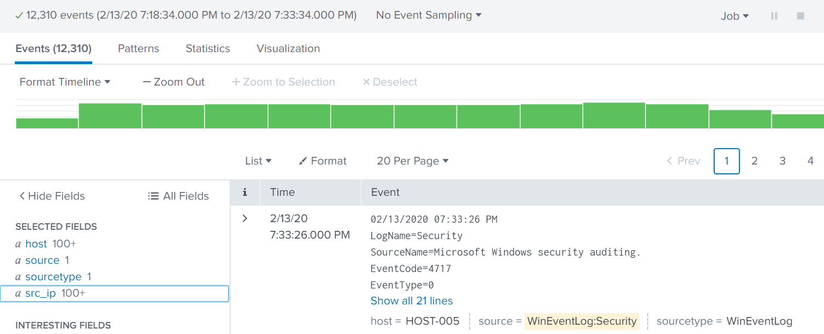
Splunk Statistics
Security professional often need to present Splunk search results to non-technical audiences using simple formats.
For example
If we need to illustrate the top 10 IP addresses from a DOS attack, this results page could be confusing to a non-expert.
‹#›

Slide 7
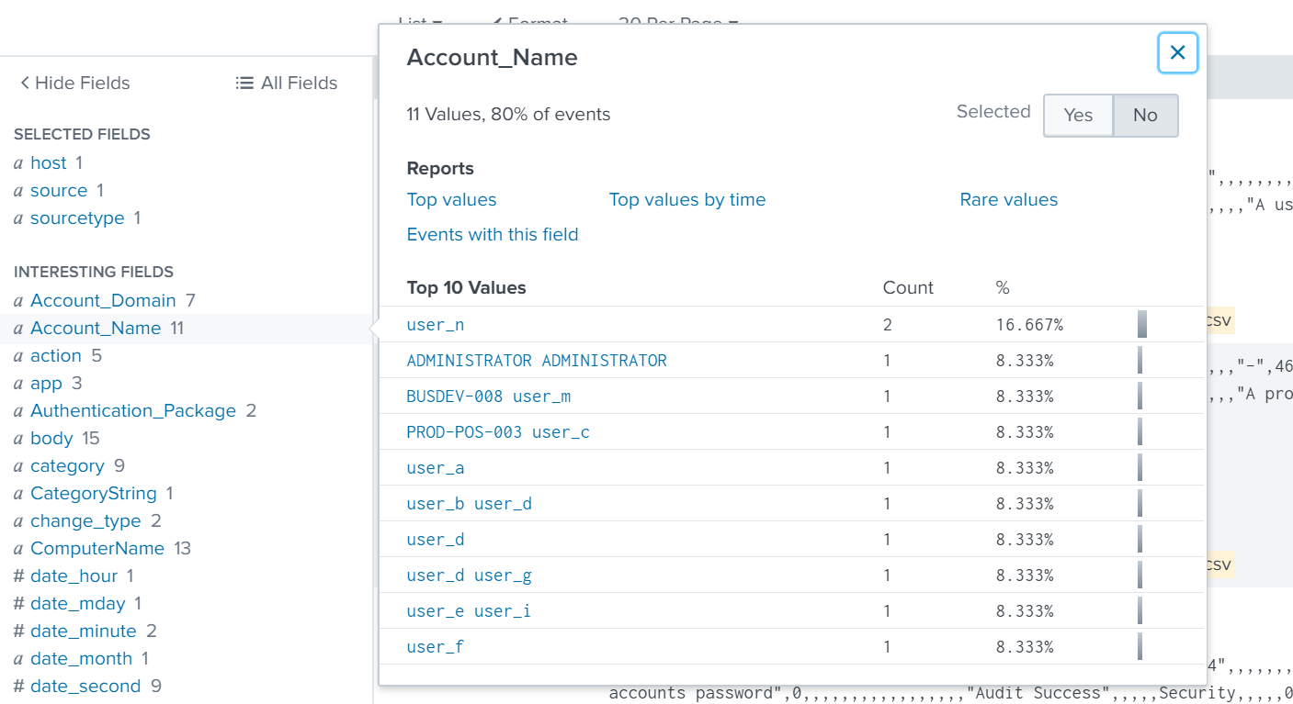
Splunk Statistics
Splunk uses the Statistics feature to display specific data points from search results in an easy-to-read format.
The stats command is the most basic Splunk command to create a statistics report.
Screenshot coming
‹#›

Slide 8

In the following demonstration, we will use the stats command to create a statistical report of the top Account_Name being targeted in a brute force attack.
‹#›

Slide 9
Splunk Statistics
‹#›

Slide 10

Creating New Fields
We can use Splunk to create new fields and display their statistics.
For example, suppose we are analyzing logs for potential brute force attempts.
Our logs have event codes (EventCode) that assign numerical codes to events.
EventCode 4740 indicates a user lockout.
Since user lockouts are a potential identifier of a brute force attack, we can create a new field to identify events that contain this event code.
If the EventCode field has a value of 4740, the field value will be Potential Brute Force.
If the field does not have a value of 4740, the field value will be Not Brute Force.
‹#›
Notes:
shutterstock_625972751

Slide 11
The eval Command
We can use the eval command expressions, such as if, and place the resulting values into a search field.
source="statsreport.csv" | eval BruteForce = if('EventCode'="4740", "Potential Brute Force", "Not Brute Force")
‹#›

Slide 12
The eval Command
We can use the eval command expressions, such as if, and place the resulting values into a search field.
Searches through all the results from the statsreport.csv file.
source="statsreport.csv" | eval BruteForce = if('EventCode'="4740", "Potential Brute Force", "Not Brute Force")
‹#›

Slide 13
The eval Command
We can use the eval command expressions, such as if, and place the resulting values into a search field.
Creates a new field called BruteForce.
source="statsreport.csv" | eval BruteForce = if('EventCode'="4740", "Potential Brute Force", "Not Brute Force")
‹#›

Slide 14
The eval Command
We can use the eval command expressions, such as if, and place the resulting values into a search field.
source="statsreport.csv" | eval BruteForce = if('EventCode'="4740", "Potential Brute Force", "Not Brute Force")
States the following expression: “If the EventCode field has a value of 4740.”
‹#›

Slide 15
The eval Command
We can use the eval command expressions, such as if, and place the resulting values into a search field.
source="statsreport.csv" | eval BruteForce = if('EventCode'="4740", "Potential Brute Force", "Not Brute Force")
Continue the statement, “If true, name this value Potential Brute Force.”
‹#›

Slide 16
The eval Command
We can use the eval command expressions, such as if, and place the resulting values into a search field.
source="statsreport.csv" | eval BruteForce = if('EventCode'="4740", "Potential Brute Force", "Not Brute Force")
Continues the statement, “If false, name this value Not Brute Force.”
‹#›

Slide 17
The eval Command
We can use the eval command expressions, such as if, and places the resulting values into a search field.
Searches through all the results from the statsreport.csv file.
Creates a new field called BruteForce.
source="statsreport.csv" | eval BruteForce = if('EventCode'="4740", "Potential Brute Force", "Not Brute Force")
States the following expression: “If the EventCode field has a value of 4740.”
Continues the statement, “If true, name this value Potential Brute Force.”
Continues the statement, “If false, name this value Not Brute Force.”
‹#›

Slide 18
Activity: Splunk Statistics
In this activity, you will create statistical reports to illustrate details about the DOS attack.
0:15
‹#›

Slide 19
‹#›

Slide 20
reports
‹#›

Slide 21

Splunk Reports
Statistical reports may need to be run at specific or reoccurring times.
For example, if an organization is experiencing suspicious network attacks around 12 a.m., they would want to analyze their network traffic every night at that time.
With Splunk, we can create and schedule custom reports to automate this task.
‹#›
Notes:
from 5.2, slide 35, shutterstock_507175969

Slide 22

Splunk Report Demonstration
In the following demonstration, we will create and schedule a report using the continued scenario of monitoring brute force attacks:
We were notified that the most recent brute force attacks happened around 12 a.m.
Therefore, we will run a report at 1 a.m. each night to view activity for the past several hours.
We'll also automate an email linking to the report after it runs.
Notes:
Image source: shutterstock_1257385045

Slide 23
Creating and Scheduling Reports

Slide 24
Activity: Splunk Reports
In this activity, you will schedule a statistical report for OMP management so they can review the current state of the attacks against a server.
0:07
‹#›

Slide 25
‹#›

Slide 26
‹#›

Slide 27
alerts
‹#›

Slide 28
Splunk alerts are designed to automatically notify the right people when a specific condition, known as a trigger condition, is met.
‹#›

Slide 29

Splunk alerts are automatic.
Once they are created, Splunk’s software checks the trigger condition.
Splunk reports are scheduled.
Splunk alerts are triggered.
(Source)
‹#›
Notes:
https://dribbble.com/shots/3712534-Warning-Sign

Slide 30

Splunk Alerts
Trigger conditions contain the following criteria:
01
02
03
Search/Report Results Indicate which criteria to check.
Time parameters Indicate the time period to check.
Schedule Determines the frequency with which these criteria are checked.
For example: 300 logins have been attempted.
For example: Within last 24 hours.
For example:
Every day at 12 p.m.
‹#›

Slide 31
Splunk Alerts
When the condition is met, a trigger action is executed to alert the Splunk user. For example:
"Send an email to soc_manager@acme.com."
‹#›

Slide 32
Baselining
‹#›

Slide 33


Designing Strong Alerts
A required skill for designing strong alerts is being able to avoid false positives and false negatives.
 | False Positives | False Negatives
What Occurred | Regular login activity | Brute force attack
Alerts | Yes | No
Outcome | Alerts went off but security professionals identified a non-issue. | No alerts went off, a brute-force attack occurred and several accounts were breached.
‹#›
Notes:
shutterstock_309813590

Slide 34
False Positives
False positives occur when conditions are met and an alert is triggered, but the security situation did not actually occur.
For example, an alert was created to detect suspicious login activity on our Linux server.
The chosen criteria checks activity every hour and creates an alert when 10 logins occur within an hour.
Several alerts were triggered, but further research determined they were set off by normal user activity.
SOC realizes that 10 login attempts within an hour is not very suspicious.
‹#›

Slide 35
False Negatives
False negatives occur when the condition is met and an alert isn’t triggered, allowing the security event to go undetected.
For example, an alert was created to detect suspicious activity of logins on our Linux server.
The chosen criteria checks activity every hour and creates an alert when 500 logins occur within an hour.
Suspicious login activity did occur on the server when an attacker tried to brute force the Linux server with 400 attempts, but no alerts were triggered.
‹#›
Notes:
shutterstock_309813590

Slide 36
Setting a Baseline Threshold
Baselining is a method of looking at historical data to determine typical activity, known as a threshold. When the threshold is exceeded, an alert is triggered.
Setting the threshold too high
risks missing an alert.
Setting the threshold too low
creates too many false positives.

Slide 37
Baselining
‹#›

Slide 38

Alert Fatigue
Alert fatigue occurs when security professionals receive so many alerts that they are prevented from adequately responding to each one.
Even when an organization builds good alerts and an alert gets triggered, security professionals will need to research and respond to it.
If an organization’s system triggers too many alerts, even if they are good alerts, security professionals will often miss issues as they get lost in the noise.
‹#›
Notes:
shutterstock_1229109085

Slide 39
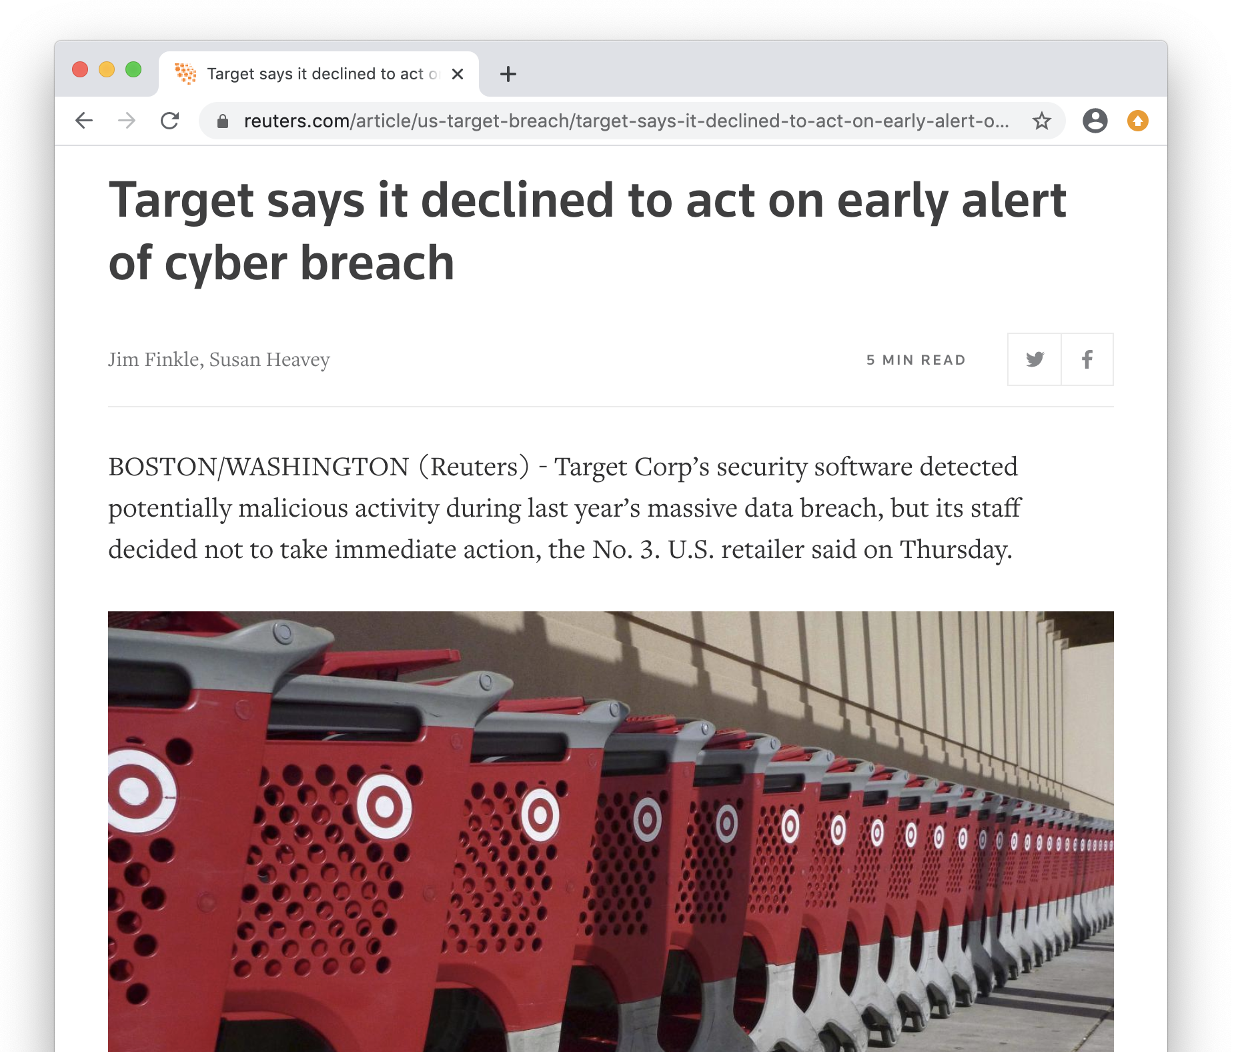

Alert Fatigue
Alert fatigue can have a major impact on organizations:
In 2014, a breach at Target cost the company $252 million and led to the resignation of its CIO and CEO.
One of the company’s security products actually detected the breach.
But due to the high quantity of alerts and the frequency of false alerts,the company’s IT security team ignored it.
(reuters.com)
‹#›

Slide 40
Activity: Baselining
In this activity, you will review logs and create a baseline of typical hourly login counts.
0:15
‹#›

Slide 41
‹#›

Slide 42
Creating and Scheduling Alerts
‹#›

Slide 43

Creating an Alert
Now that we can determine accurate baselines, we can continue with our scenario and design the alerts.
More than 30 logins per hour
In the following demonstration, we will design an alert to trigger when 30 logins occur in an hour.
Check the count every hour
Send an email when alert is triggered
We will set this alert to check the count every hour.
Once the alert is triggered, an email will be sent.
‹#›
Notes:
shutterstock_635799140

Slide 44
Creating and Scheduling Alerts
‹#›

Slide 45
Activity: Creating and Scheduling Alerts
In this activity, you will design and schedule an alert to notify your team if a brute force attack is occurring.
0:10
‹#›

Slide 46
‹#›

